Slide 1
FURNITURE SHOP MANAGEMENT SYSTEM

Slide 2
ABSTRACT
In this title "Furniture Shop Management System" which is a shop management system to manage furniture shop business and it is implemented with inventory management. There are 5 main modules in this system, which are user profile management, purchase management, sales management stock management and Billing management.
The problem statements of this thesis are the current management system does not have well inventory management. There does not have the facilities to handle the receipts and issues of stock.
The second problem is this current management system is manually system which records the information of staff and supplier, stock record, and sales report in paperwork. There are two (2) objectives of this thesis, which are to develop a systematic inventory management of Furniture Shop Management System (FSMS) and to provide a good storage stock and retrieve data information in this furniture shop management system.
This thesis is discussed on how this furniture shop management system to be implemented, the tools and programming languages used, and the resources needed in developing this system. Prototyping is used to develop this project. The strength of Furniture Shop Management System is implemented with the well inventory management to manipulate the inventory of the shop.

Slide 3
HARDWARE SPECFICATION
Processor : P 4 700 GHz.
RAM : 4 GB RAM
Hard Disk Drive : 180 GB

Slide 4
SOFTWARE SPECIFICATION
Operating System : Windows 7/8/10
Front End : JAVA
Back End : MYSQL

Slide 5
EXISTING SYSTEM
This existing system is fully handled by man power, which takes lot of paper based. So, it’s a waste of money for the furniture shop manager. Purchased and stocked details are very risk to handle by the shop manager. It takes too much time for calculating the amount.
DRAWBACKS:
The existing system has the following drawbacks.
Does not keep track of purchase.
Does not keep track of stock.
Very risk to calculate billing details manually.

Slide 6
PROPOSED SYSTEM
The proposed system of ‘Furniture management system’ is that reduce these kinds of issues, which may help to develop the furniture shop. Every product should be register when purchasing the product same as every product should be mentioned before sales the product
FEATURES:
Helps furniture shops to automate furniture selling.
Purchase and sales report details.
Provide billing details systematically

Slide 7
Modules
Furniture Registration
Customer Registration
Purchase Management
Sales Management
Billing Management

Slide 8
Furniture Registration
This module helps to collect the information for the all type of furniture details. The details are entered by the admin. This module has furniture name, types, brand name, quality and price etc… it’s an main module to this application because the concept of the titles matches to this module.
Customer Registration
This module have collect and store the customer information to database table. This details will be store in the customer table. When the customer came and purchase some product admin ask the information about the customer and register the details.

Slide 9
Purchase Management:
Shop owner or an admin will be using this module, what ever the products has purchase in the shop every records should be register before sale. Because then only we can calculate the stock details and managing the sales.
Sales Management
The sales management module will be taking care of the sales of the product. When the customers are purchasing the product it should be register and collect the information from the customer as well.
Billing Management
Can see the billing details in same application by the duration period. The admin or shop owner can see and compare the billing details on each days. This is module has the report of this application.

Slide 10

Data Flow Diagram
Level 0:

Slide 11
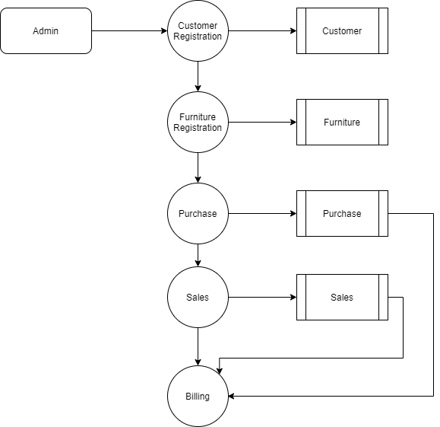
Level 1:

Slide 12
TABLE DESIGN TABLE NAME:ADMIN
FIELD | DATA TYPE | SIZE | CONSTRAINT
Admin id | Int | 10 | Primary key
Username | Varchar | 30 | Not null
password | Varchar | 30 | Not null

Slide 13
TABLE NAME:CUSTOMER
FIELD | DATA TYPE | SIZE | CONSTRAINT
employee id | Int | 10 | Primary key
Name | Varchar | 20 | Not null
Mobile | Int | 10 | Not null
Alternate | Int | 10 | Not null
Salary | Int | 30 | Not null
Gender | Varchar | 10 | Not null

Slide 14
TABLE NAME:CUSTOMER
FIELD | DATA TYPE | SIZE | CONSTRAINT
Customer id | Int | 10 | Primary key
Name | Varchar | 20 | Not null
Mobile | Int | 10 | Not null
Alternate | Int | 10 | Not null
Address | Varchar | 30 | Not null
Gender | Varchar | 10 | Not null

Slide 15
TABLE NAME:FURNITURE
FIELD | DATA TYPE | SIZE | CONSTRAINT
Furniture Id | Int | 10 | Primary key
Company | Varchar | 30 | Not null
Model | Varchar | 30 | Not null
Price | int | 10 | Not null

Slide 16
TABLE NAME:PURCHASE
FIELD | DATA TYPE | SIZE | CONSTRAINT
Purchase id | Int | 10 | Primary key
Product id | Int | 10 | Foreign key
Quantity | Int | 5 | Not null
Details | Varchar | 30 | Not null
Date | date | 10 | Not null

Slide 17
TABLE NAME:SALES
FIELD TABLE NAME: | DATA TYPE | SIZE | CONSTRAINT
Sales id | Int | 10 | Primary key
Customer id | Int | 10 | Foreign key
Product id | Int | 10 | Foreign key
quantity | int | 5 | Not null

Slide 18
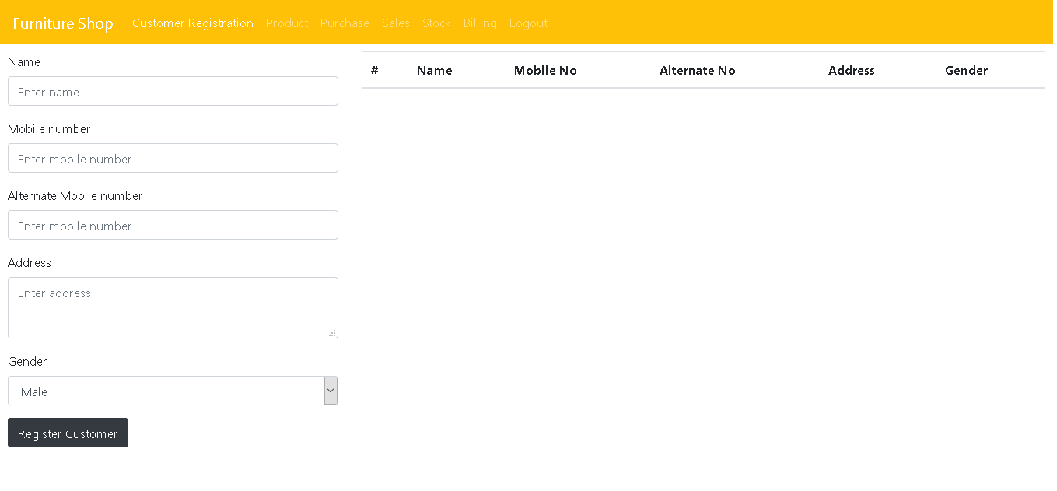

Slide 19
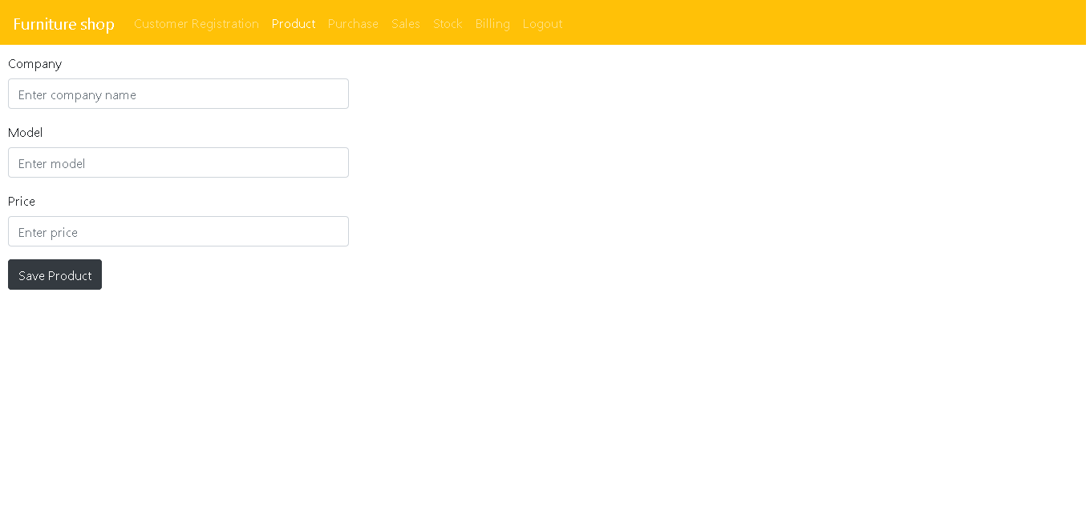

Slide 20
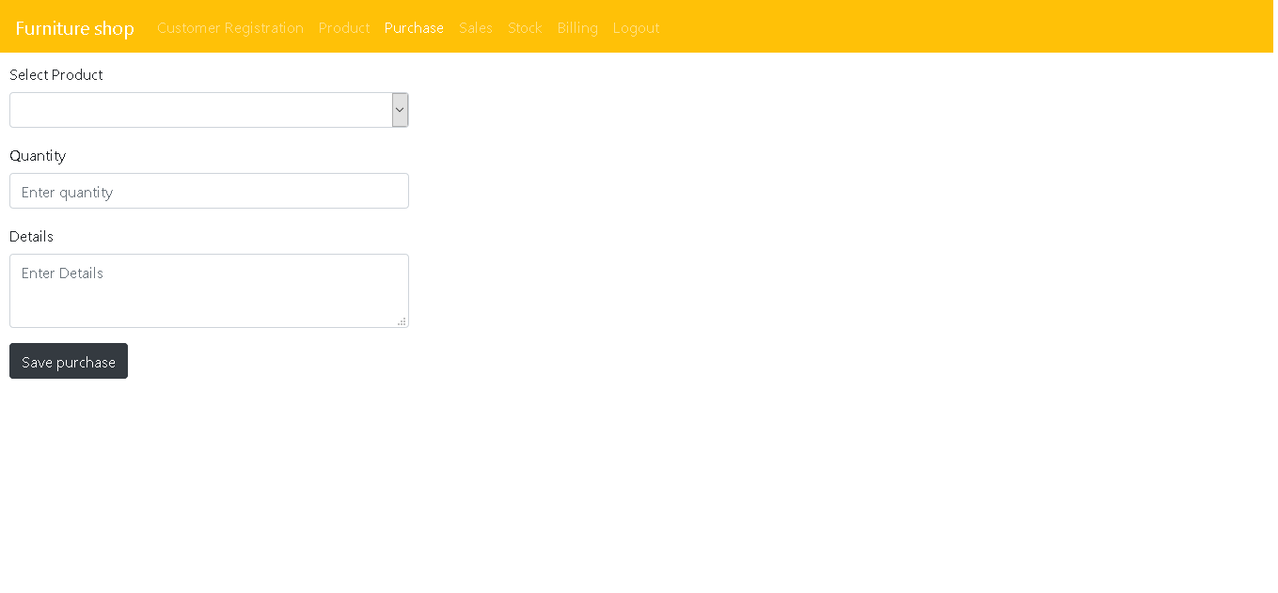

Slide 21
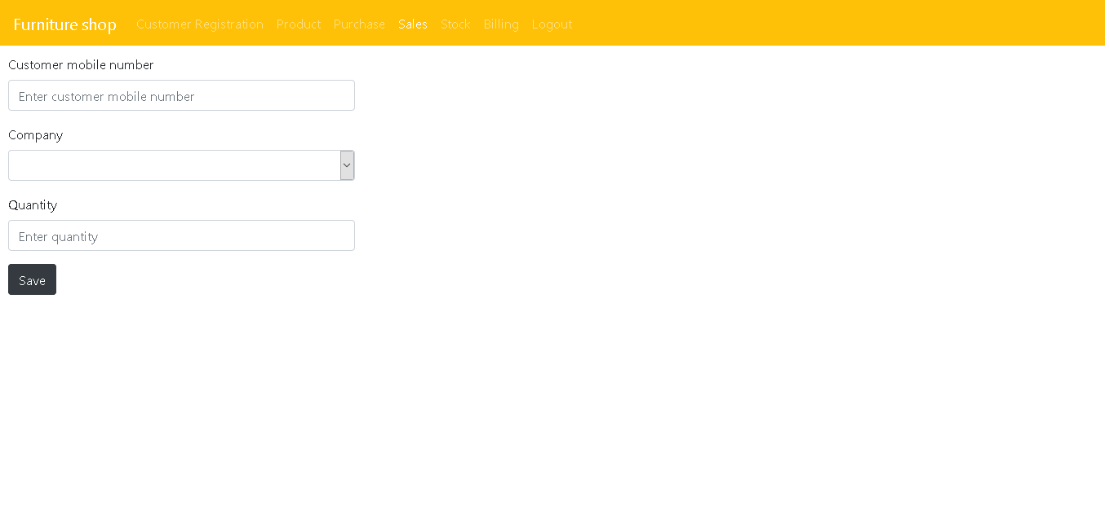

Slide 22
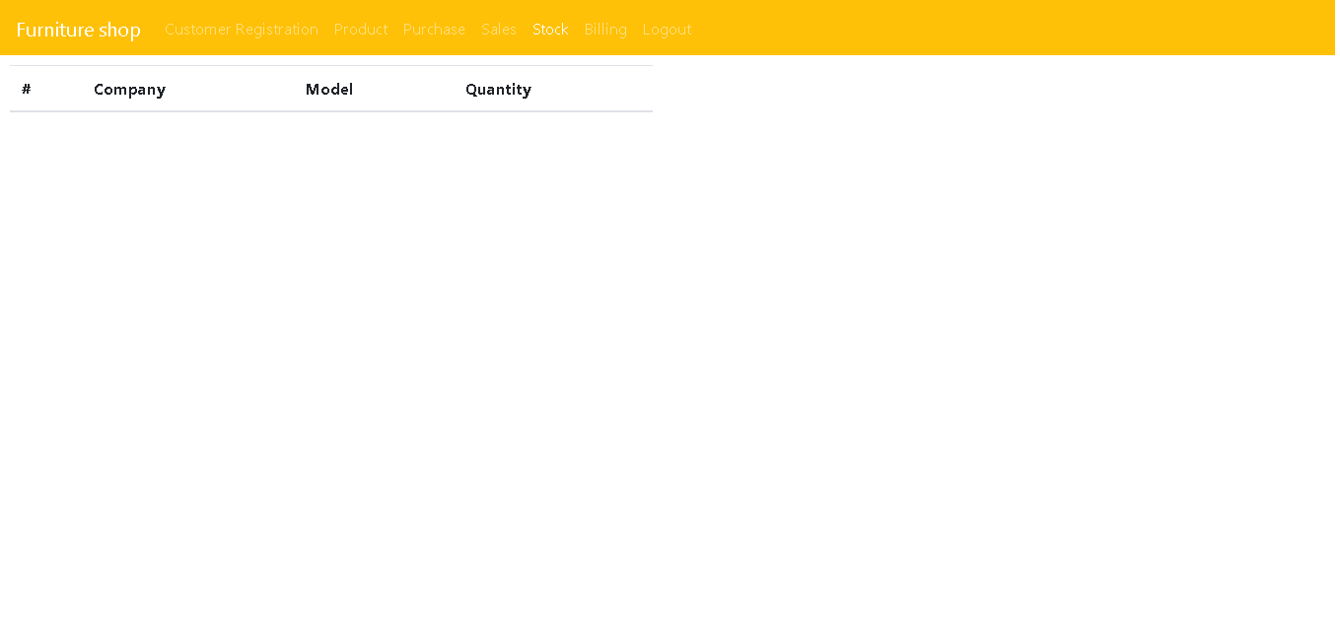

Slide 23
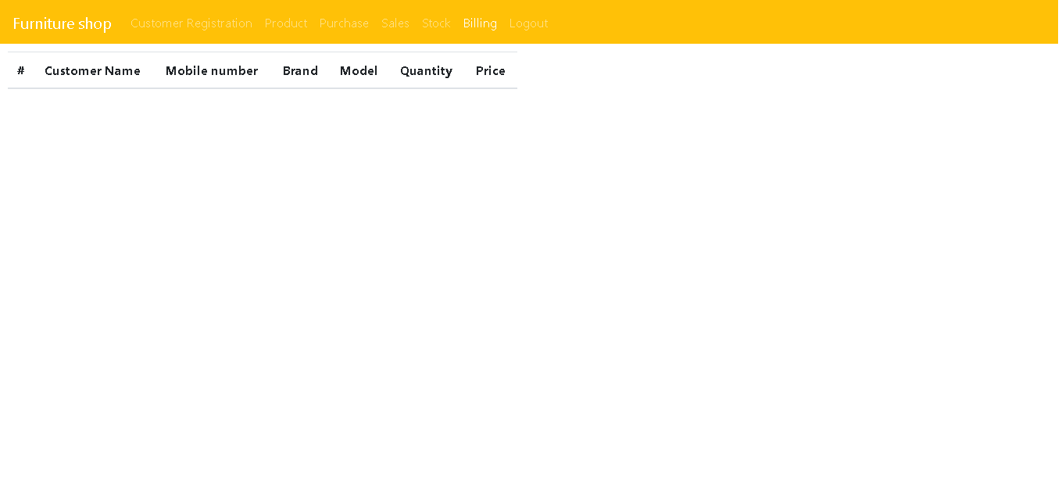

Slide 24
Thank You

